Slide 1
Introduction and Overview
NE 591: Nuclear Fuel Performance
Dr. Benjamin Beeler

Slide 2

Brief Bio/Background
Computational Nuclear Materials Scientist
Expertise in advanced nuclear fuels
Ph.D. in Nuclear Engineering from Georgia Tech
Previously a staff scientist at Idaho National Laboratory in Fuel Modeling and Simulation Group
Atomistic simulations: density functional theory and molecular dynamics

Slide 3
My viewpoint/approach
Scientifically informed engineering is a multiscale problem
Critical phenomena need to be identified from the macroscale, and informed from the lower length scales
Perform good science, sometimes for science’s sake, but often to address a key engineering problem or need

Slide 4
Syllabus
Course Overview
In this course we will study the basic role of fuel in reactor operation and understand how the fuel impacts heat generation and transport to the coolant. The course will begin with an overview of different fuels and the fabrication processes required to construct nuclear fuel. We will also study various fuel types and geometries, with a focus on light water reactor fuel and cladding. We will then study changes in the fuel and cladding material that degrade the performance of the fuel. Finally, student will apply knowledge gained to conduct fuel performance simulations.
Learning Outcomes
By the end of this course, the student should be able to:
Understand the basics of fuel fabrication
Calculate the rate at which heat is transported to the coolant from the fuel
List the most important microstructural changes that take place in the fuel and cladding and how they impact fuel performance
Use an existing fuel performance code

Slide 5
Planned Topical Outline
Introduction and Overview
Fuel types
Fuel fabrication
Thermal transport
Mechanical behavior
Materials issues in the fuel
Materials issues in the cladding
Used fuel disposition
Overview of fuel performance codes
Utilization of fuel performance codes
Graded Exercises
Three exams
One written project
One final project
Will see about homework…

Slide 6
Office Hours
Tentatively Wednesday’s 10-11 am
If this doesn’t work, we can find some other time on Wednesday
My office door may be closed, but I am still probably inside, so feel free to drop my if you have a pressing question

Slide 7
Complete nuclear fuel cycle

Slide 8
Emphasis on In-Reactor Behavior of Fuel
The full reactor system is complex and substantial, and there are separate NE courses covering this area
Although the fuel is a relatively small part of a reactor system, it determines thermal power, which drives electric power generation
The performance of the fuel is measured by:
How much heat is delivered to the coolant
The length of time it operates without any problems
How well it performs during an accident

Slide 9
How much heat is delivered to the coolant?
Heat transport is related to thermal conductivity
In single crystal, pristine materials, thermal conductivity is reasonably straightforward
In dynamic, radiation environments, thermal conductivity degrades, fission gas bubbles form, grain boundaries are generated and destroyed
How does thermal conductivity vary?

Slide 10
The length of time fuel operates without any problems
There are 98 operating nuclear reactors in the US, producing 20% of the electricity
The net capacity factor is the ratio of an actual electrical energy output to the maximum possible electrical energy output over a period of time
Nuclear reactor capacity factor is ~92% over the past decade
The ability to maintain high capacity factor, limit shutdown time, is key in making nuclear power economical
Fuel is the primary component forcing reactor downtime

Slide 11
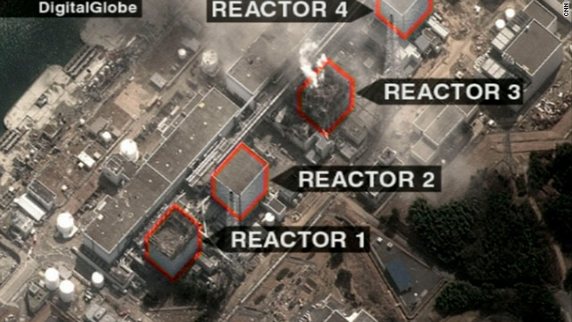
Fuel behavior during accidents
Fukushima
In addition to normal operating conditions, the behavior of the fuel during accidents is of critical importance
Predictable, and hopefully stable, behavior is desired during a variety of accident scenarios
Even low impact accidents are detrimental to public opinion surrounding nuclear energy

Slide 12
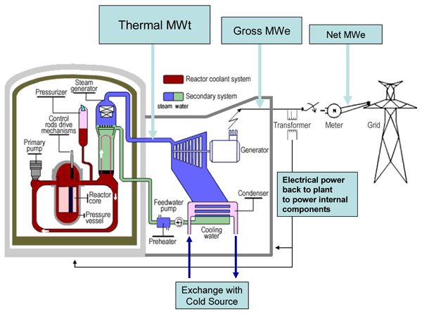
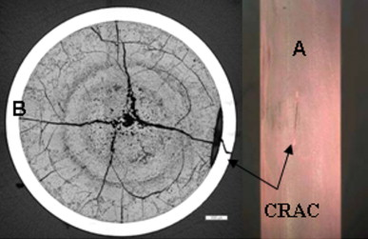
All of these factors together represent what we call “fuel performance”
Fuel Performance
Heat generation
Fuel problems causing unscheduled outages
Fuel behavior during an accident

Slide 13
Comments
THIS IS THE FIRST TIME THIS CLASS IS BEING TAUGHT AT NCSU
THIS IS THE FIRST CLASS I AM TEACHING
I wanted to make sure that this class is able to meet the needs of the students, provides relevant information, and is taught at a level commensurate with the abilities of the students.
I will need your feedback as we go along to make sure these goals are met.

